Slide 1
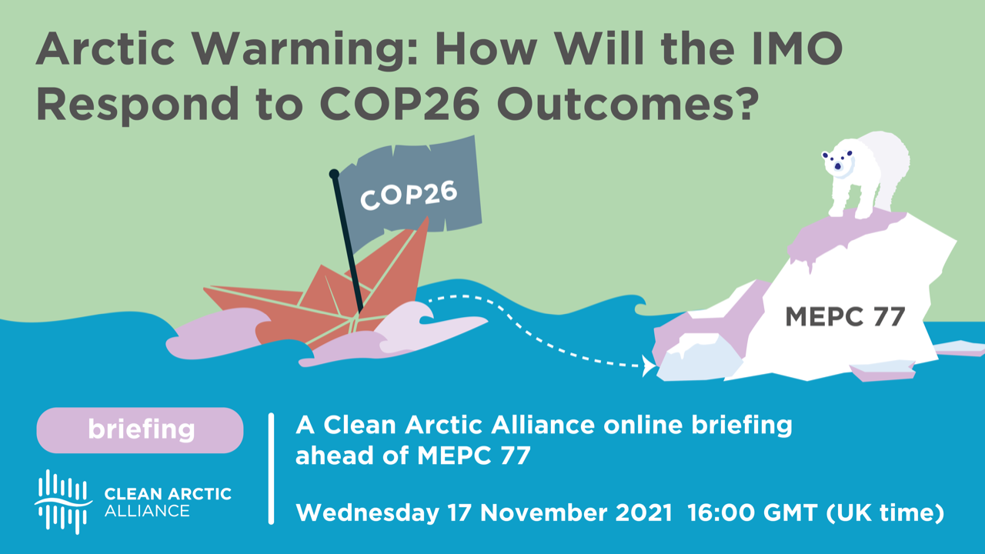

Slide 2



Dr Lucy Gilliam
Senior Policy Officer Shipping, Seas At Risk
John Maggs
President, Clean Shipping Coalition
Dr Sian Prior
Lead Advisor, Clean Arctic Alliance

Slide 3
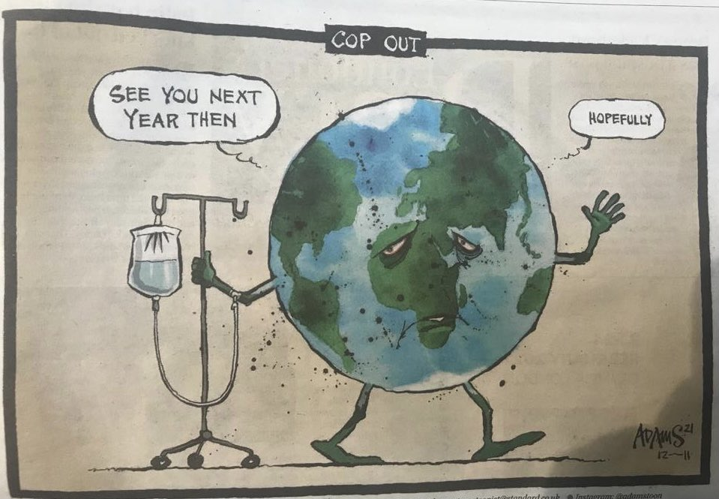
Attention at COP26 was on 2030 climate goals and keeping the 1.5 Degree goal ‘alive’
Shipping was visible at COP26 and now must deliver at MEPC 77
Still lack of short term action & commitment

Slide 4
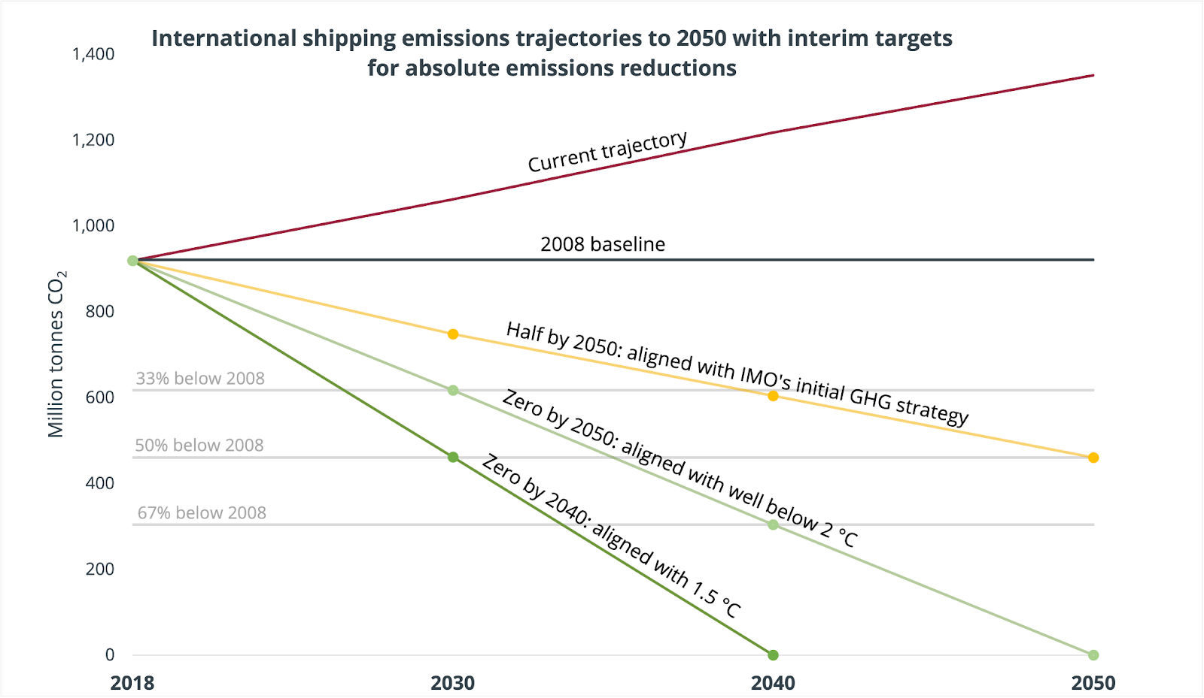
https://theicct.org/blog/staff/marine-shipping-imo-ghg-targets-global-sept21

Slide 5

Time Up for Black Carbon (BC)
BC is a powerful, short-lived climate pollutant
BC emissions from Arctic shipping increased 85% between 2015 – 2019
Action to reduce BC emissions will improve human health and mitigate climate change
At MEPC 77, IMO Members should adopt a Resolution on BC urging voluntary use of distillate fuel with low aromaticity
BC

Slide 6


Questions for our panel?
Contact us:
Twitter: @CleanArctic
Visit: hfofreearctic.org
Email: info@cleanarctic.org

